Slide 1
Making elections accessible to all: Accessible voting in 2021
IAAF October 2021
Whitney Quesenbery
Center for Civic Design
@whitneyq @civicdesign
Slides: bit.ly/iaaf2021

Slide 2
Civil rights, voting rights, disability rights
Civil Rights Act 1964
Voting Rights Act 1965
Language Assistance Act 1992
Nat’l Voter Registration Act 1993
Equal Rights Amendment
1972
Help America Vote Act 2002
Obergefell v. Hodges 2015
Architectural Barriers Act 1968
Rehabilitation Act 1973
Americans with Disabilities Act 1990
Section 508
1998
WCAG 1.0 1999
WCAG 2.0 2008
VVSG 1.0 2006
VVSG 1.1
2015
Telephone
1900
Fax machines
1980
Windows 3
1990
Google 1998
MacOS
2001
iPhone
2007

Slide 3
The voting system shall be… accessible for individuals with disabilities….[providing] the same opportunity for access and participation (including privacy and independence) as for other voters
Help America Vote Act of 2002 Section 301

Slide 4
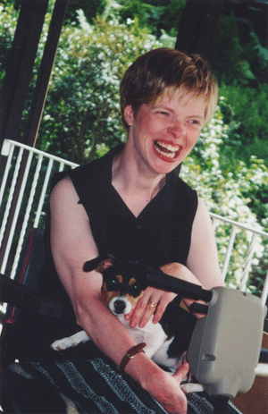
“I feel like technology is finally catching up with what I truly need.”
Glenda Watson Hyatt
I’ll Do It Myself

Slide 5
The burning question
Why are we still talking about accessible voting in 2021

Slide 6
Are there really enough voters whose disability really prevents them from voting with the voting options already available to them?
I get asked this question too often!

Slide 7
This is over 20% of the voting age population
This many | Have disabilities that affect voting
19.1 M | have trouble seeing
28.3 M | have physical difficulty, including grasping and handling small objects
30.8 M | have trouble hearing
17.8 M | speak English “less than well”
9.2 M | live in linguistically isolated households
Source: Brennan Center, The Machinery of Democracy: Accessibility, Usability, and Cost, 2006

Slide 8
But the challenge is much bigger
This many | Or this percentage | Of this group of potential voters | Have problems that affect voting
11 M | or 22% | adults over 65 | Mobility, dexterity, vision or hearing disability
30 M | or 13% | literate adults | Read at “below basic levels”
63 M | or 29% | literate adults | Read at “basic” levels
45 M | 35% | voters (based on 130M voters in November 2016) | Are “low propensity “ or infrequent voters
Sources: Older Americans Month, 2017 – US Census Bureau, National Assessment of Adult Literacy, US. Dept of Education, 2003
Engaging new voters, NonProfit Vote

Slide 9
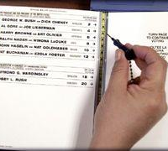
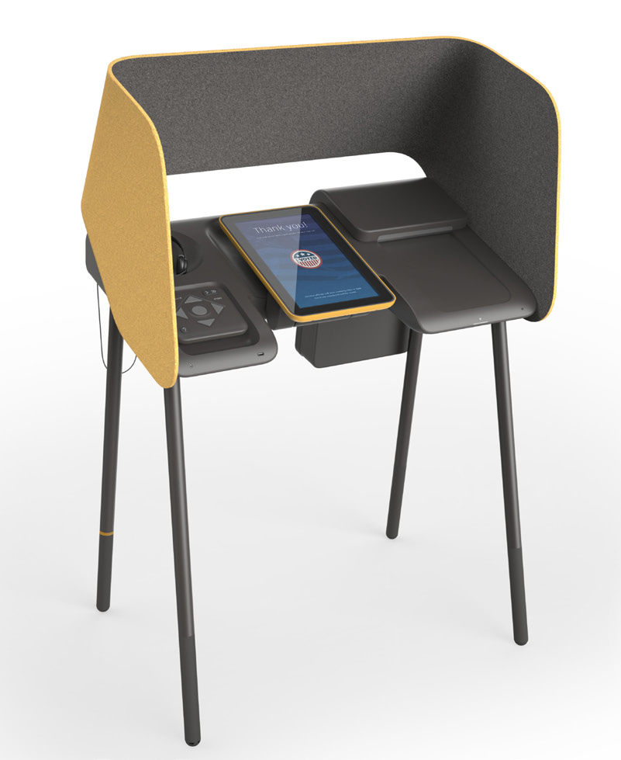
We’ve come a long way
In 2020, Los Angeles County went from one of the most backward voting systems to the most advanced.
lavote.net

Slide 10
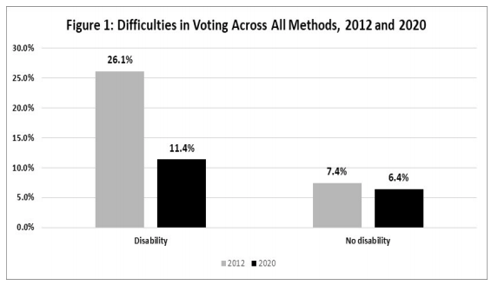
The difficulty of voting declined markedly in 2020
Disability and Voting Accessibility in the 2020 Elections: Final Report on Survey Results
Lisa Schur and Douglas Kruse, Rutgers University

Slide 11
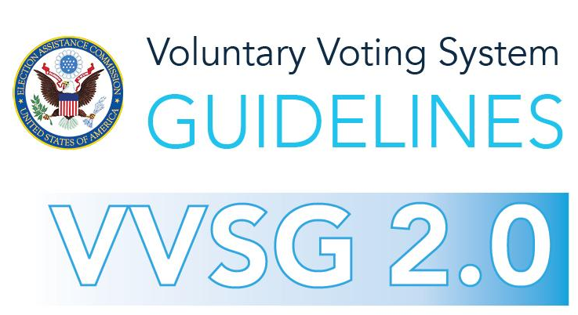
February 10, 2021

Slide 12
VVSG 2.0 is organized around principles for elections
Principle 2.2 User-centered design
Principle 5 Equivalent and consistent voter access
Principle 6 Voter privacy
Principle 7 Marked, verified and cast as intended (perceivable, operable, understandable)
Principle 8 Robust, safe, usable, and accessible

Slide 13
Within any method of voting, all display formats including enhanced visual and audio and all interaction modes including tactile and limited dexterity must have the same functionality as the visual format and touch mode including voting, verification, and casting.
VVSG 2.0 requirement Principle 5 – Equivalent and consistent voter access
5.1-A Voting methods and interaction modes

Slide 14
The voting system must provide at least the following display format and interaction mode options to enable voters to mark their ballot to vote, and verify and cast their ballot, supporting the full functionality in each mode: 1. Visual format 2. Enhanced visual format 3. Audio format 4. Touch mode 5. Limited dexterity mode.
VVSG 2.0 requirement Principle 7 – Marked, verified and cast as intended
7.2-A Voting methods and interaction modes

Slide 15
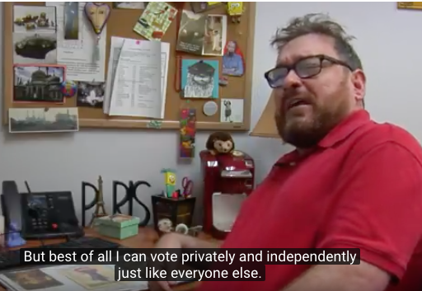
Flexible options make a difference for everyone
Vote-by-mail
More early voting
Vote at any vote center
Remote accessible voting
PSA by Disability Rights CA https://www.youtube.com/watch?v=54-Xbg5Nbg4&feature=youtu.be

Slide 16
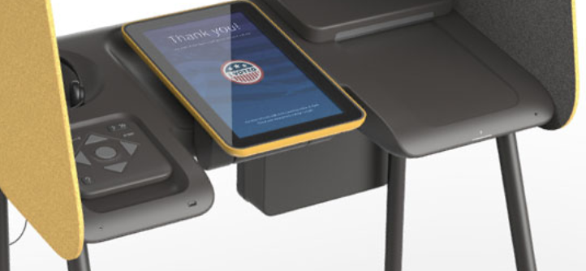
Ballot marking systems and voter verification
Making voting both accessible and secure

Slide 17
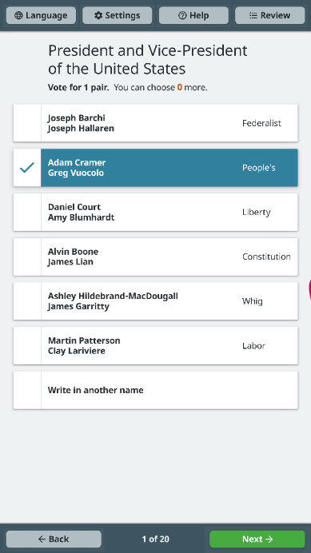
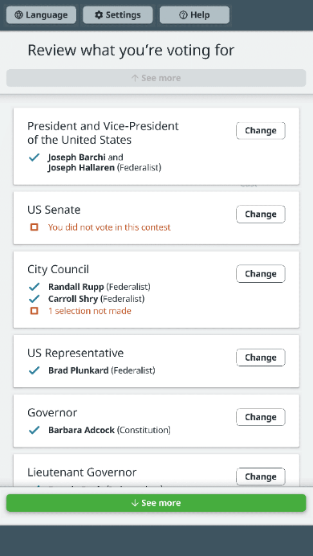
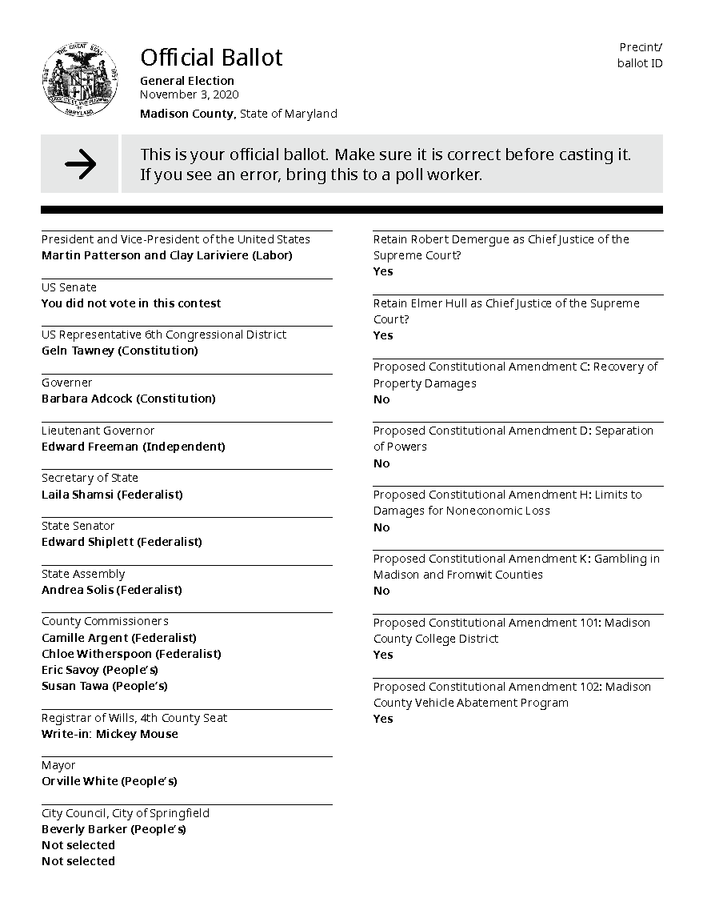
Ballot marking systems Mark, review, print, verify, cast

Slide 18
VVSG 2.0 must clearly and unambiguously state a position that segregated voting systems are discriminatory and not acceptable for a VVSG 2.0 approved voting system. All voters using the same ballot marking interface ensures non-discrimination.
Comments submitted during the VVSG 2.0 Public Comment period in 2020

Slide 19
[Accessible voting systems] should be allowed only if the disabled community still wants to use them after being advised of the security risks.
Paraphrase of an argument against making accessible voting systems available to anyone who wants to use them.

Slide 20
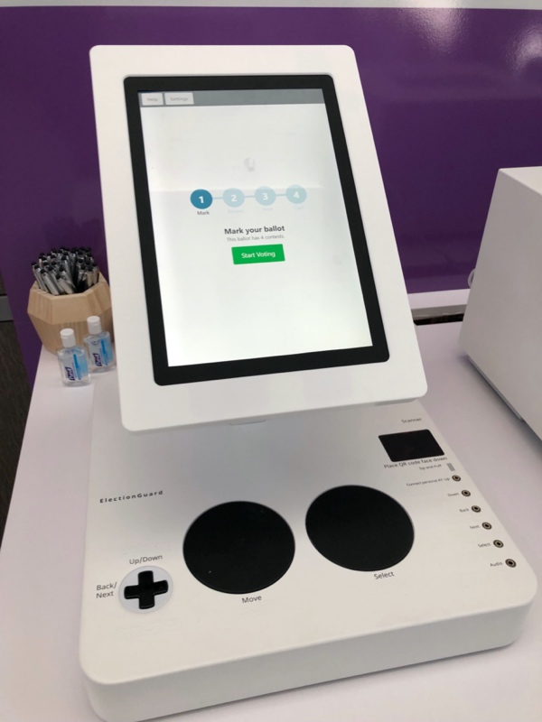
New technology investigations ElectionGuard
Open source software that makes voting more secure, transparent and accessible using end-to-end cryptography

Slide 21
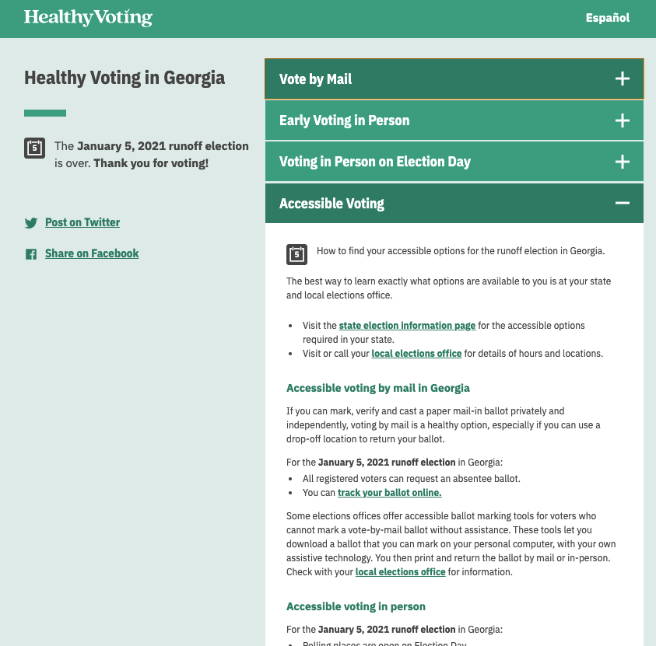
Better information for accessible voting
https://civicdesign.github.io/ Accessible-Voting-Index/

Slide 22

Executive Order 14019 Promoting access to voting
People with disabilities continue to face barriers to voting and are denied legally required accommodations in exercising their fundamental rights.

Slide 23
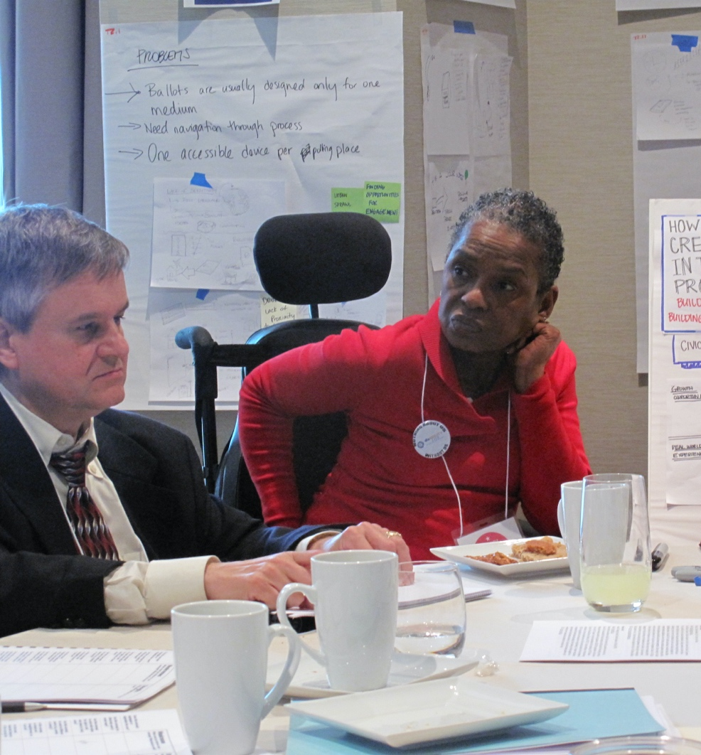
Design all voting systems for all people
Election systems designed and tested with the people who will use it.

Slide 24
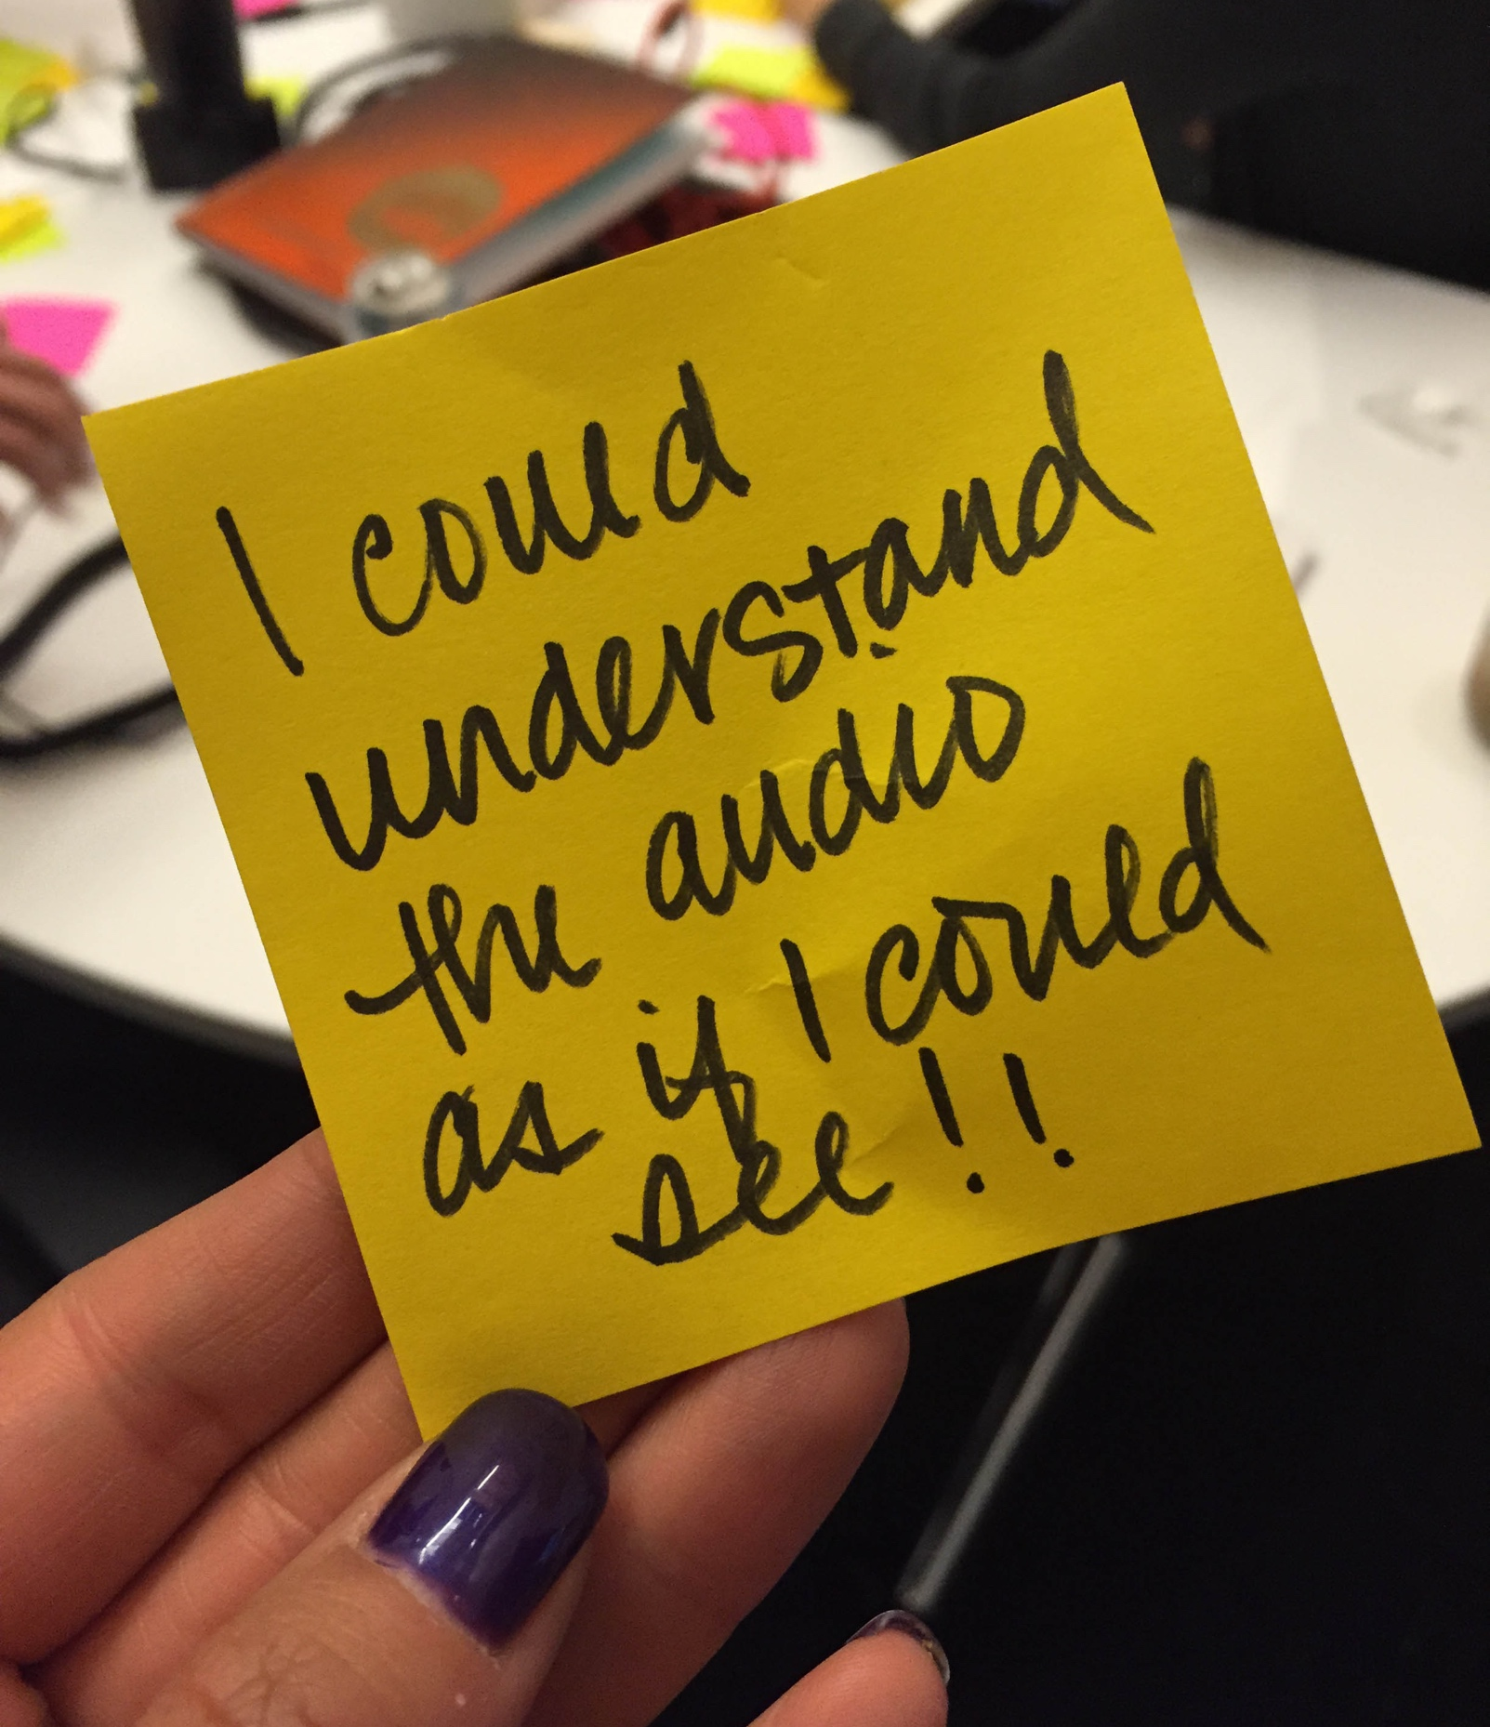
Make it easer to be a voter
A good voting experience for all should be easy and delightful

Slide 25
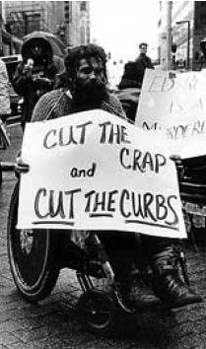
Voting ^{[with a disability]} is a civil right
Accessible information
Accessible forms for participation
Accessible polling places
Accessible voting systems
So that all voters can mark, verify, and cast their ballot independently and privately, choosing when and where they vote.
Photo: mtstcil.org

Slide 26
Links to follow up with
Principles for remote ballot marking systems
https://civicdesign.org/projects/remote-ballot-marking/
Research for NIST and the Working Group https://civicdesign.org/projects/roadmap/
EAC Voluntary Voting System Guidelines https://www.eac.gov/voting-equipment/voluntary-voting-system-guidelines
Five Cedars Group Alternative Format Ballot https://www.fivecedarsgroup.com/
Los Angeles County Voting System for All People
https://vsap.lavote.net/
ElectionGuard
https://www.electionguard.vote/

Slide 27

Thank you Whitney Quesenbery whitneyq@civicdesign.org @whitneyq civicdesign.org @civicdesign

